Slide 1
NEW SPRINT
Sprint | PROJECTMMYY
Particulars | To use Water Fall Methodology for all Projects so that there is no change in the middle, budget is fixed and estimated time frame to complete the project can be achieved, ensure all approvals are received before starting the new project, ensure all required material is arranged so that the project is not affected, ensure necessary contracts are given based on negotiation & collection of stocks, ensure timely utilization of all indented items and quality materials are procured, To make plans to complete the projects without any delay achieving the committed time frame.
Start Date | 01st of Month
End Date | Last Day of Month

Slide 2
SCRUM TEAM
Scrum Master | Scrum Master
Product Owner | Incharge - Projects
Developers | Maintenance Team Purchase Team Projects Team Stores Team Civil Team – Incharge Contractor Accounts Team

Slide 3
SCRUM EVENTS
Sprint | Entire Month
Sprint Planning | 01st Day of Month
Daily Scrum | 15 Minutes – Daily
Sprint Review | 25th of Month
Sprint Retro | Last Day of Month

Slide 4

PROJECT UPDATES ARE GIVEN IN BELOW SLIDES FOR UNDERSTANDING THE LATEST POSITION

Slide 5
The following KPT CWIP Details as on 31.12.2023
Asset | SNO | Asset description | CB as on 31/12/2023 | PUT USE DATE
2150033 | 0 | NEW ADMIN BUILDING AT KPT | 2,84,99,379.66 | U/P
2150061 | 0 | CONSTRUCTION OF COMPOUND WALL 527RM & FENCING | 68,87,239.20 | Finishing work in progress
2150068 | 0 | WALL PARTITION WORK AT HTO PLANT AT REFINERY | 1,13,967.00 | U/P
2150069 | 0 | PARTITION WORK & FLOORING AT WARE HOUSE AT PACKING | 38,919.50 | U/P
2160161 | 0 | REFINERY EXTENSION-150 TPD CONTINUOUS BLEACHER | 1,53,33,472.94 | U/P
2160176 | 0 | MAGNESIUM STERATE PLANT AT WAREHOUSE 2-KPT | 18,53,932.84 | Finishing work in progress
2160197 | 0 | PHARMA STEARIC ACID PLANT | 2,71,70,399.02 | Finishing work in progress
2160448 | 0 | 20TPD DIMER FATTY ACID PLANT AT KPT | 49,45,035.21 | Closed
2160494 | 0 | ELECTROLYZER FOR GENERATION OF HYDROZEN GAS | 13,22,45,405.40 | U/P
2160534 | 0 | NEW BOILER AND POWER TURBINE PROJECT AT KPT | 5,28,602.00 | HOLD
2160715 | 0 | 30TPD DIMER FATTY ACID PLANT AT KPT | 13,06,56,062.52 | U/P
2160754 | 0 | CALCIUM STERATE PLANT AT PLASTICISERS & STABILIZER | 1,50,98,418.24 | U/P

Slide 6
The following KPT CWIP Details as on 31-01-2024
Asset | Sub number | Asset description | OB as on 01/04/2023 | Additions during the year | CB as on 31/01/2024 | PUT USE DATE
2150033 | 0 | NEW ADMIN BUILDING AT KPT | 2,65,04,318.16 | 23,01,902.50 | 2,88,06,220.66 | U/P
2150061 | 0 | CONSTRUCTION OF COMPOUND WALL 527RM & FENCING | - | 69,09,101.20 | 69,09,101.20 | Finishing work in progress
2150068 | 0 | WALL PARTITION WORK AT HTO PLANT AT REFINERY | - | 1,13,967.00 | 1,13,967.00 | U/P
2150069 | 0 | PARTITION WORK & FLOORING AT WARE HOUSE AT PACKING | - | 38,919.50 | 38,919.50 | U/P
2160161 | 0 | REFINERY EXTENSION-150 TPD CONTINUOUS BLEACHER | 1,50,46,520.94 | 2,86,952.00 | 1,53,33,472.94 | U/P
2160176 | 0 | MAGNESIUM STERATE PLANT AT WAREHOUSE 2-KPT | - | 20,67,167.54 | 20,67,167.54 | Completed
2160197 | 0 | PHARMA STEARIC ACID PLANT | 2,71,70,399.02 | - | 2,71,70,399.02 | Finishing work in progress
2160494 | 0 | ELECTROLYZER FOR GENERATION OF HYDROZEN GAS | 13,07,904.21 | 13,46,35,789.93 | 13,59,43,694.14 | Commissioning work in progress
2160534 | 0 | NEW BOILER AND POWER TURBINE PROJECT AT KPT | 18,602.00 | 5,10,000.00 | 5,28,602.00 | HOLD
2160715 | 0 | 30TPD DIMER FATTY ACID PLANT AT KPT | - | 15,11,51,887.93 | 15,11,51,887.93 | U/P
2160754 | 0 | CALCIUM STERATE PLANT AT PLASTICISERS & STABILIZER | - | 2,10,86,464.66 | 2,10,86,464.66 | U/P

Slide 7
ELECTROLYSER
PLANT
PHOTOS

Slide 8
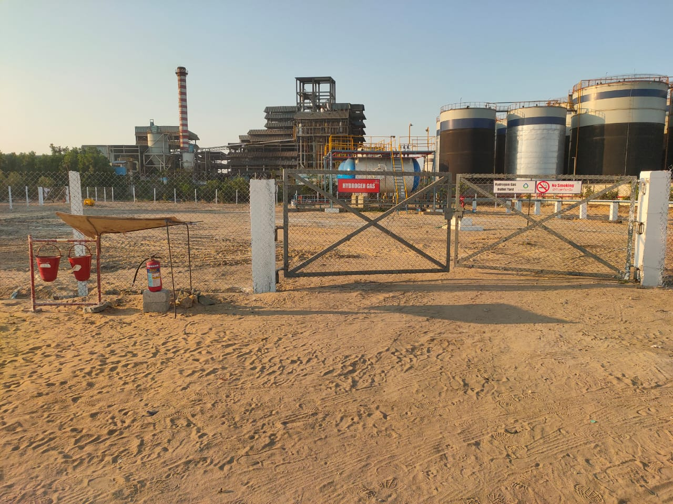

Slide 9
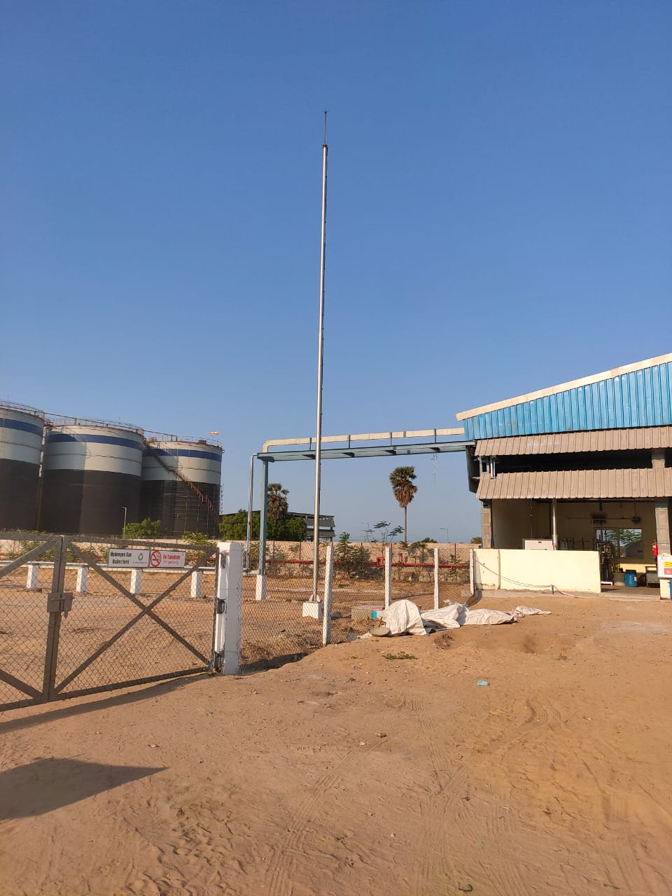

Slide 10
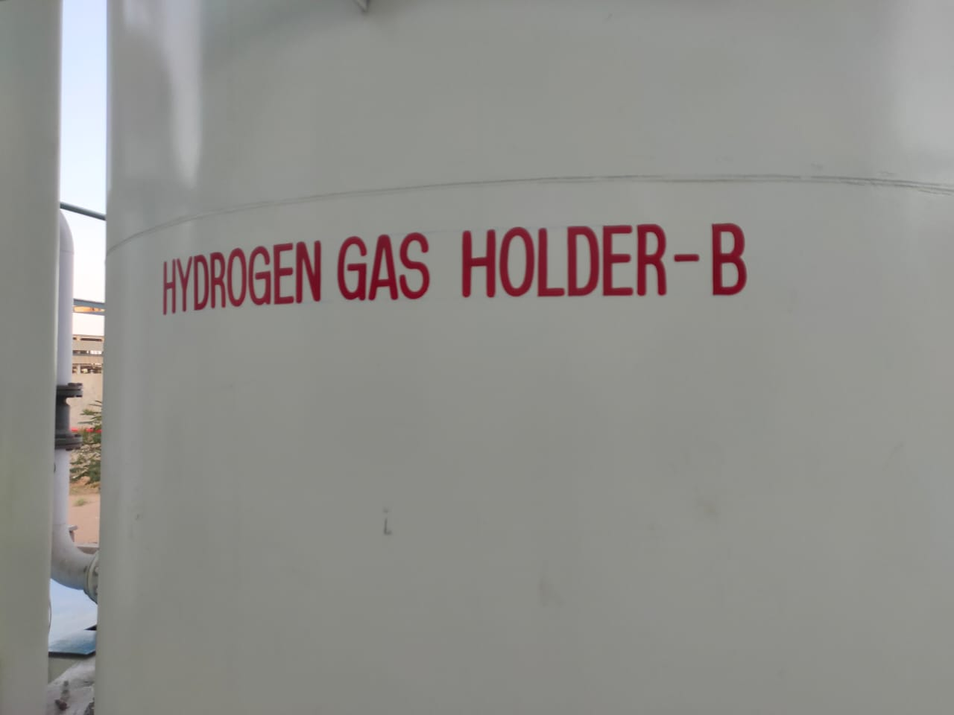

Slide 11
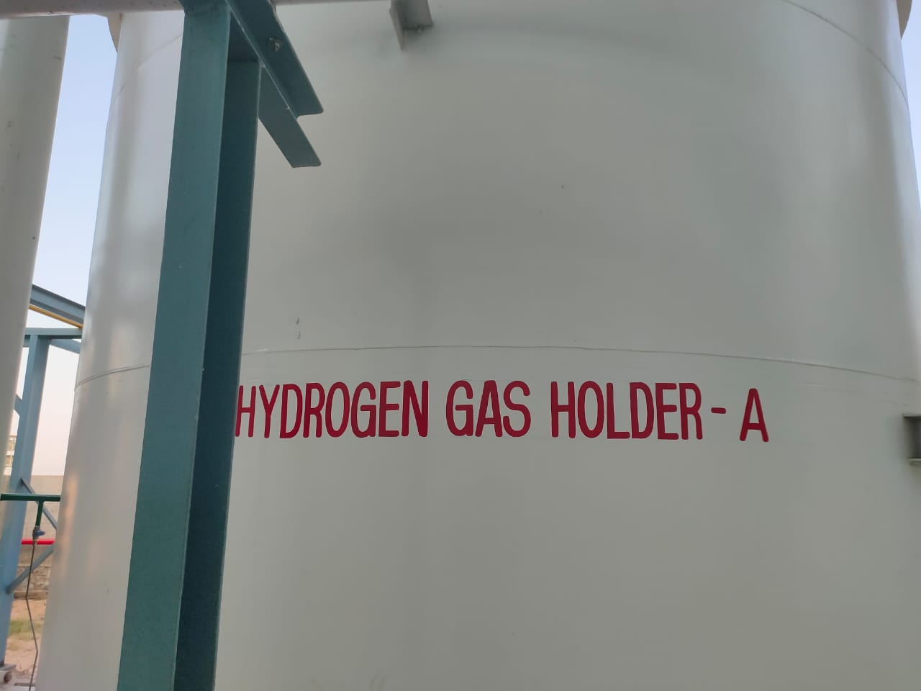

Slide 12
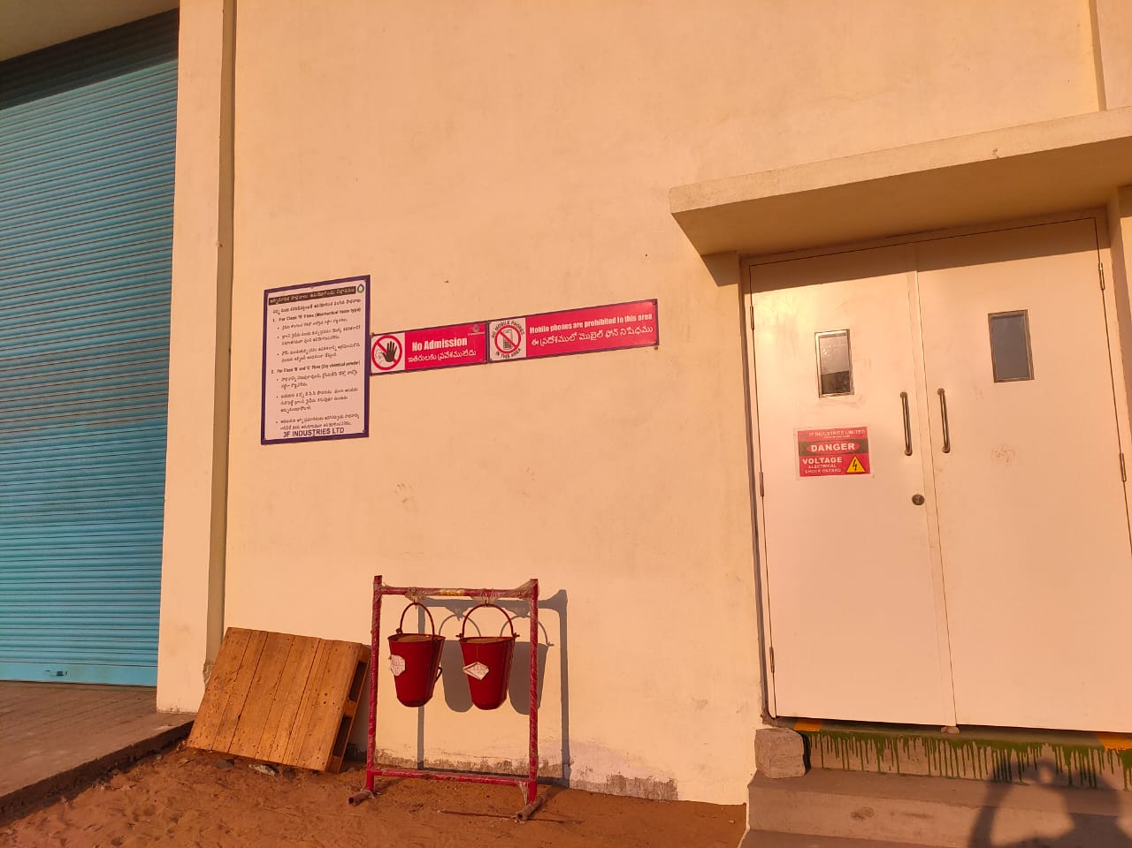

Slide 13
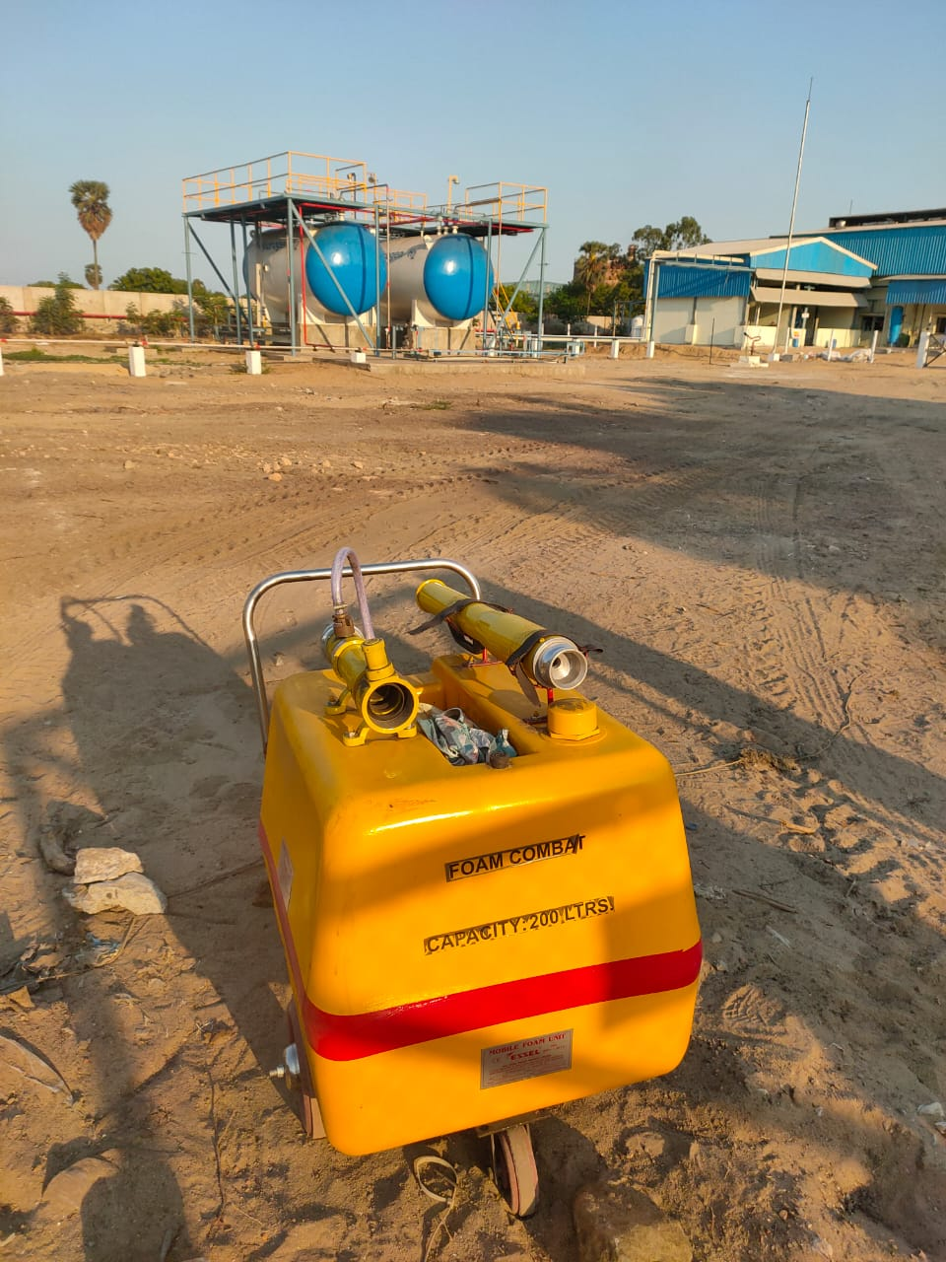

Slide 14
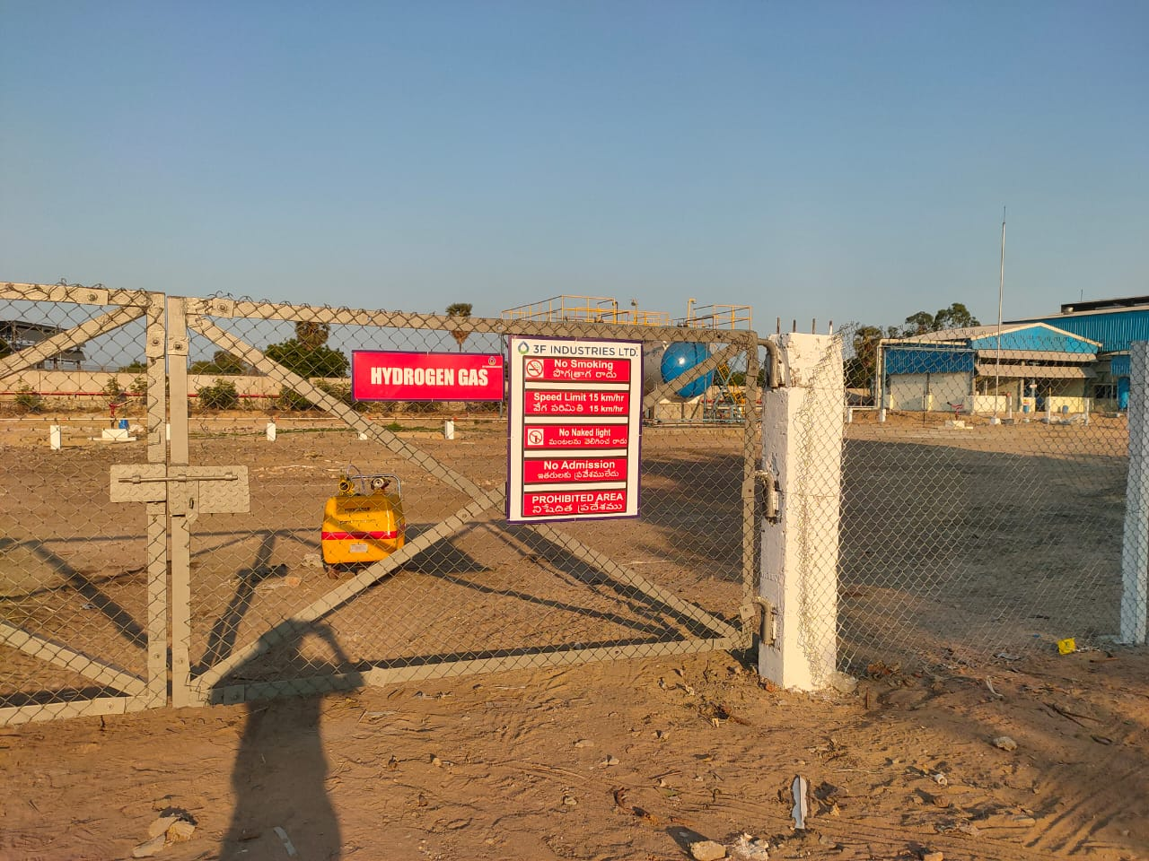

Slide 15
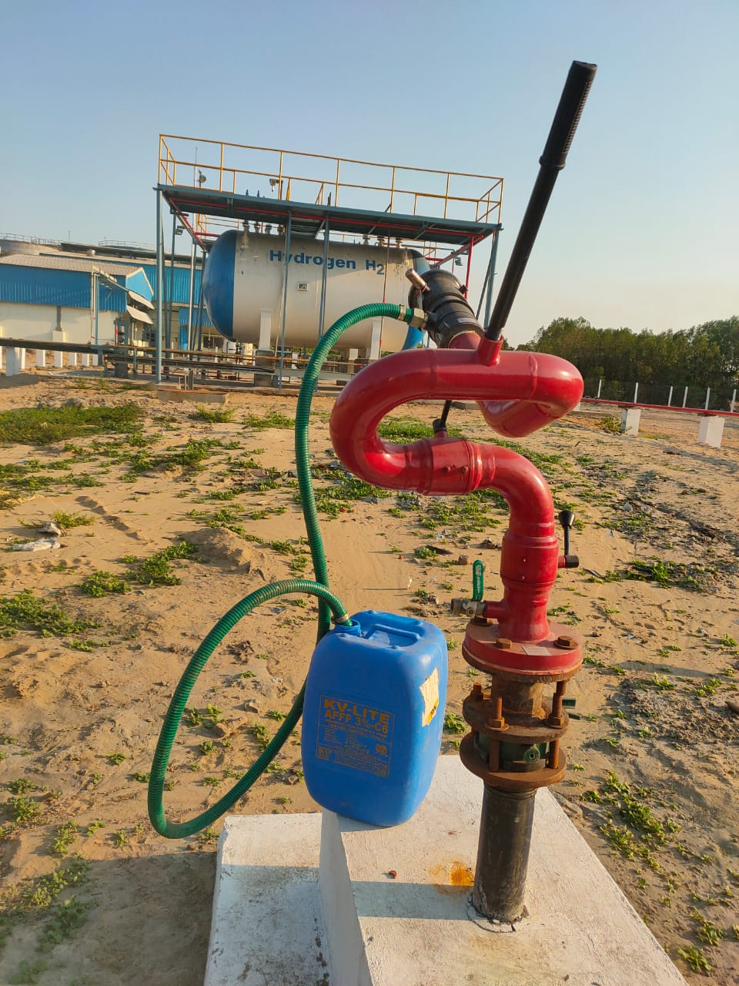

Slide 16
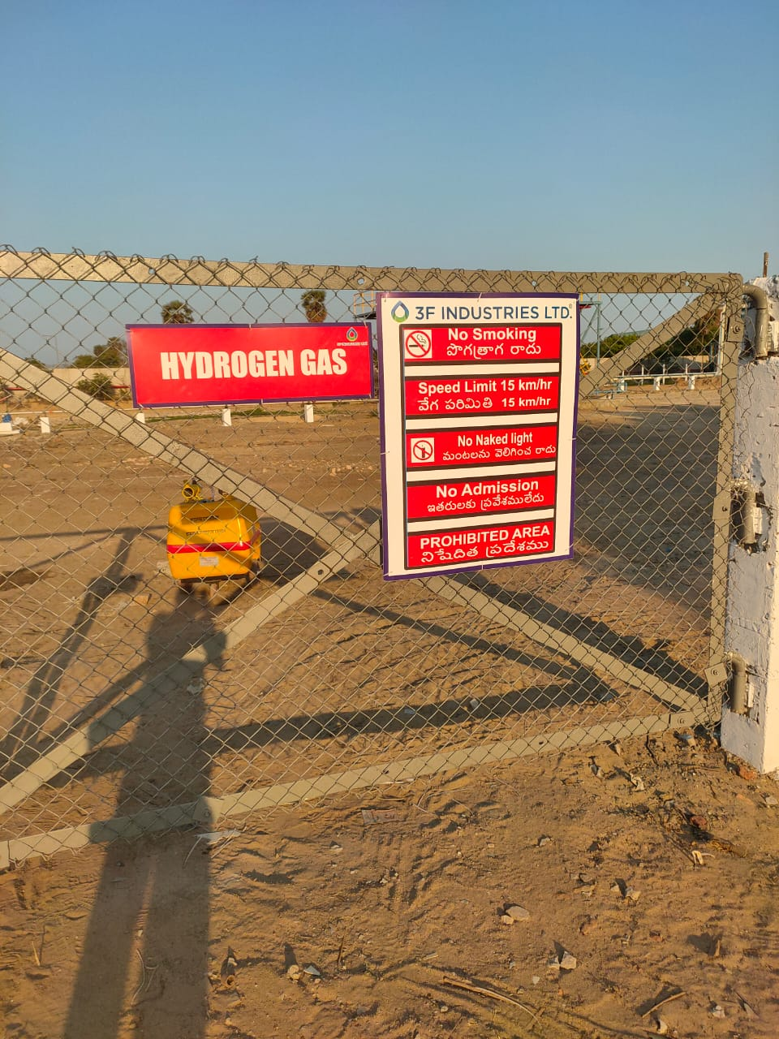

Slide 17
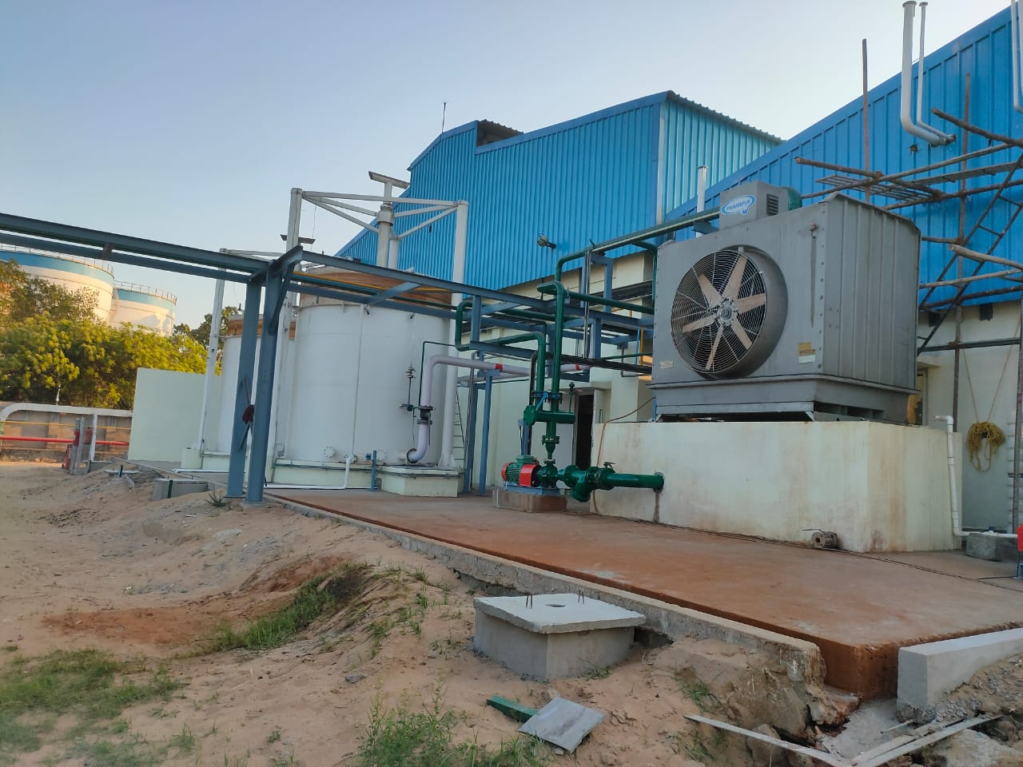

Slide 18
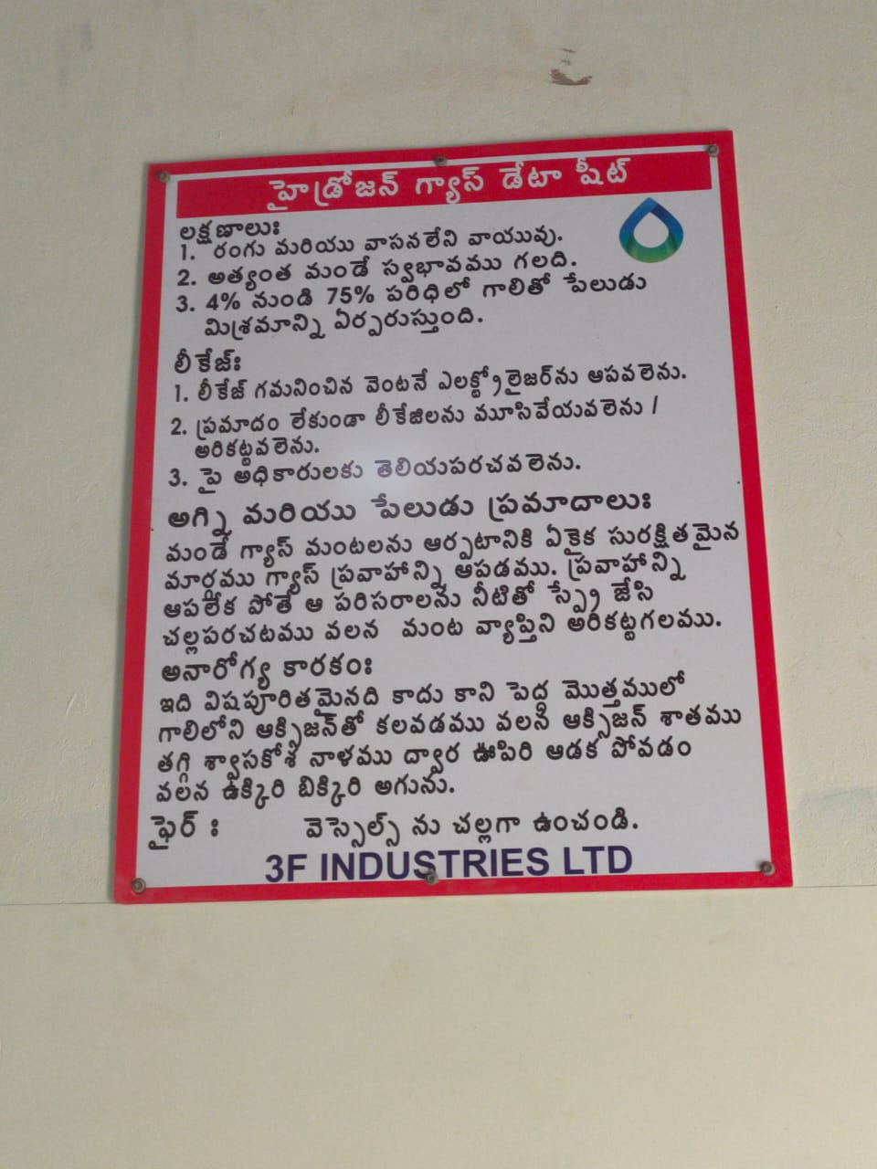

Slide 19
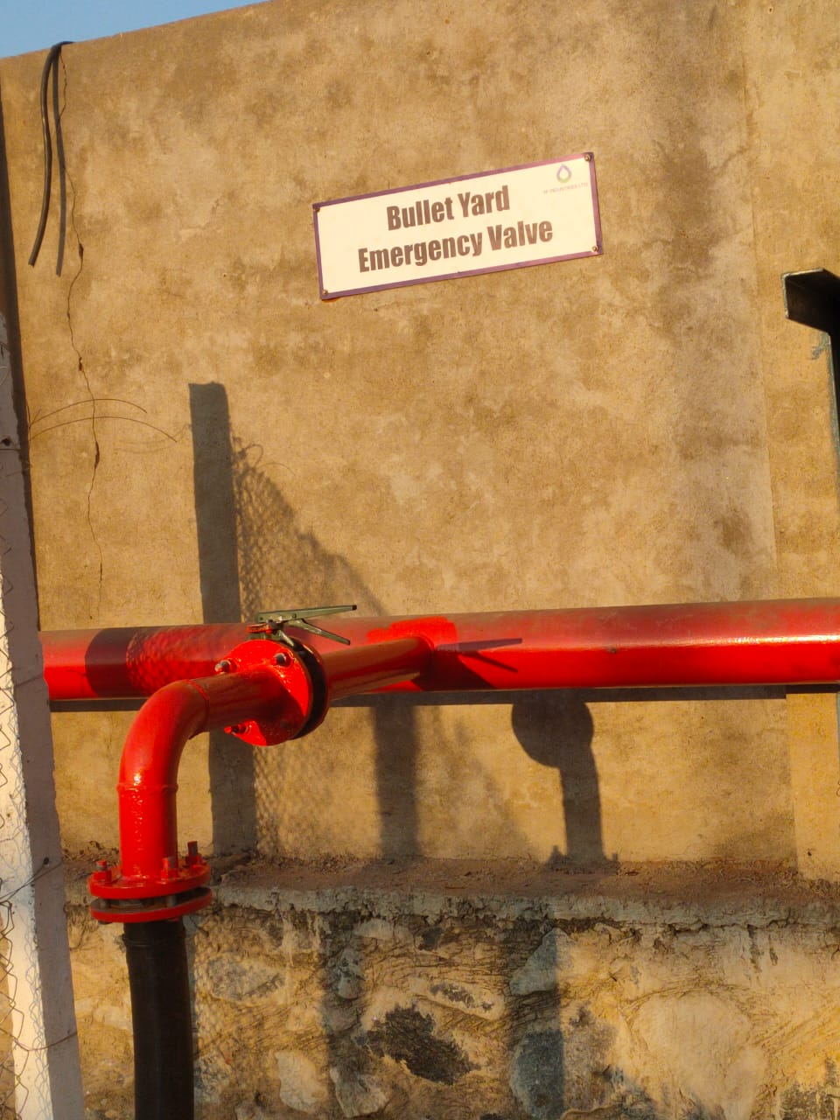

Slide 20
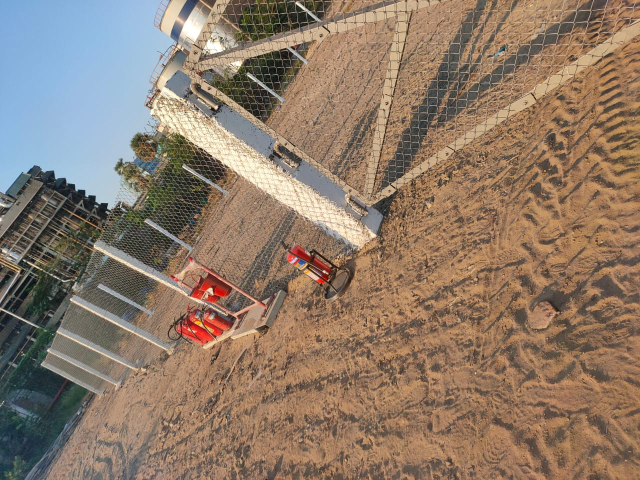

Slide 21
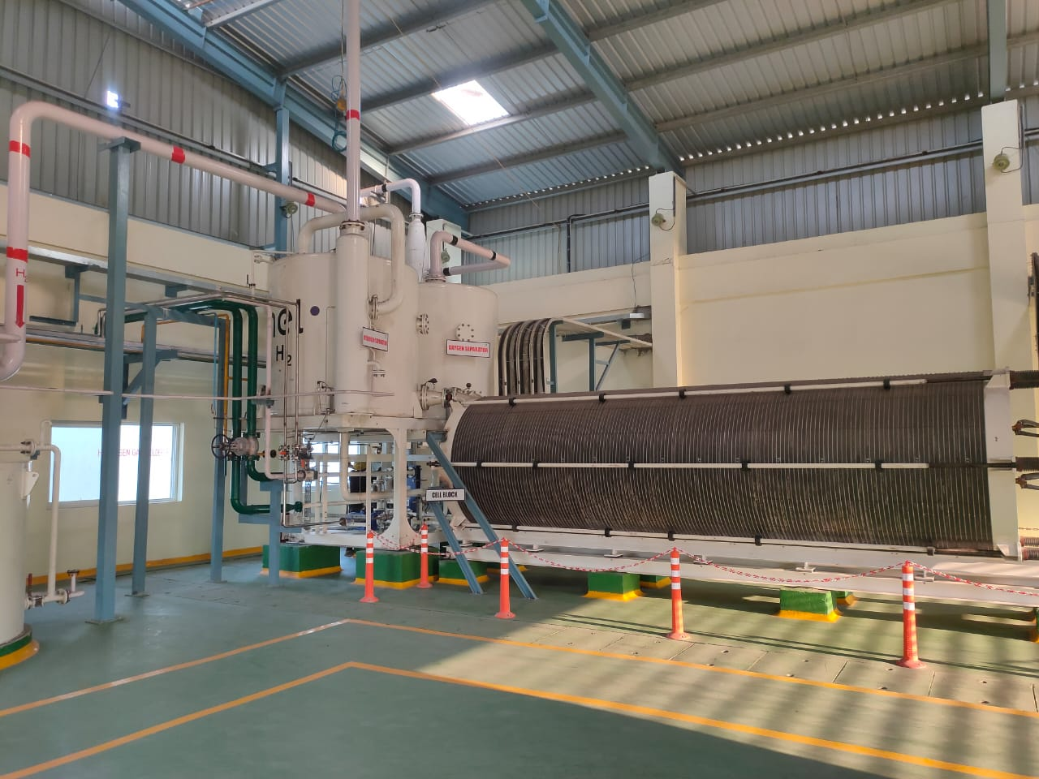

Slide 22
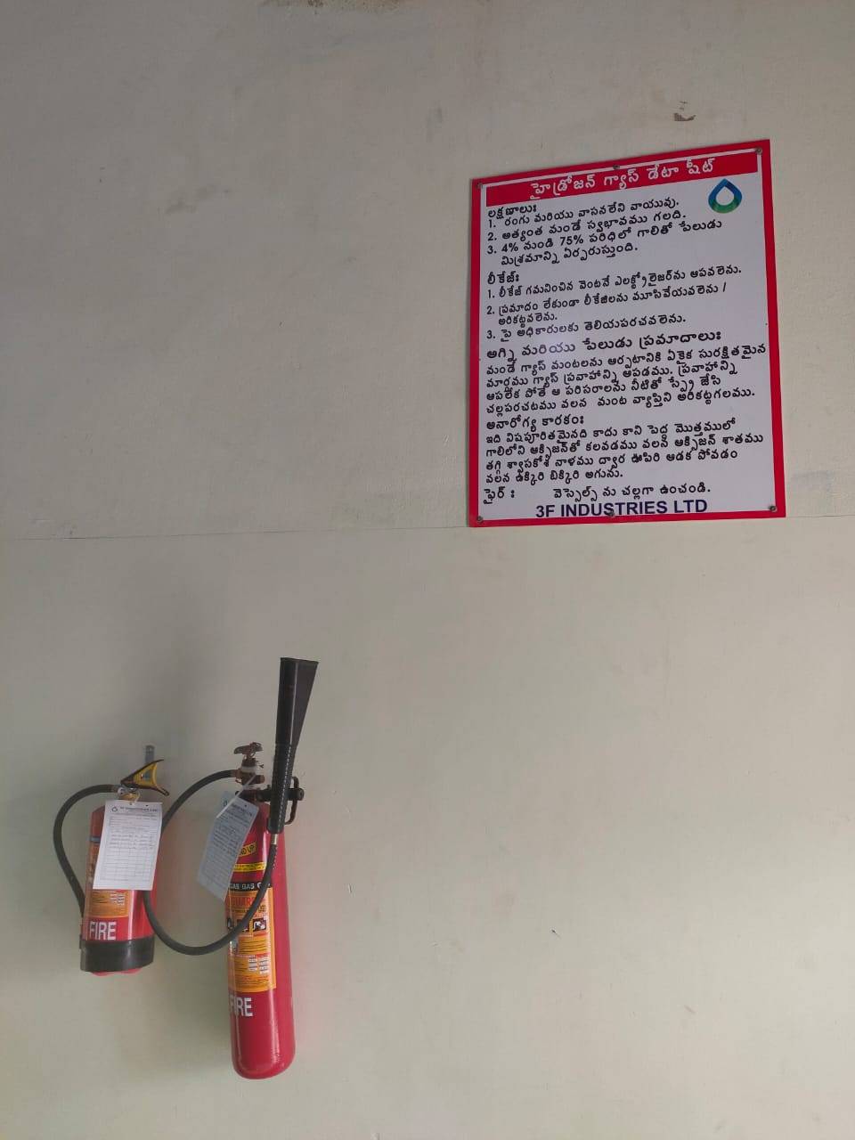

Slide 23
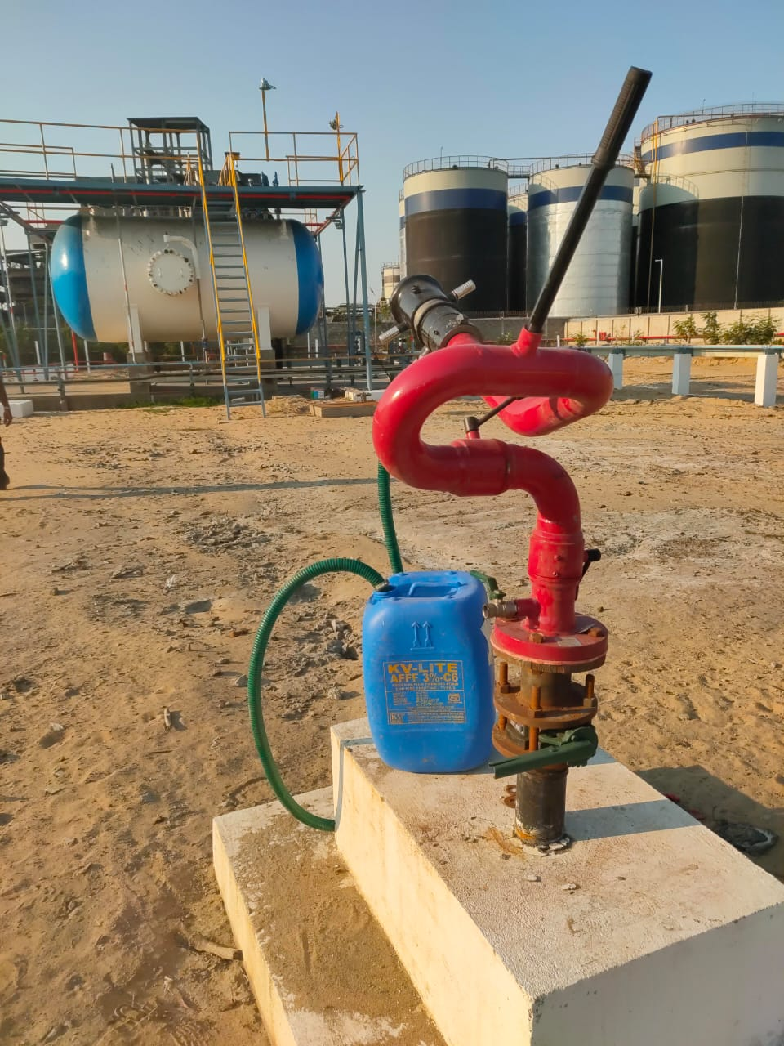

Slide 24
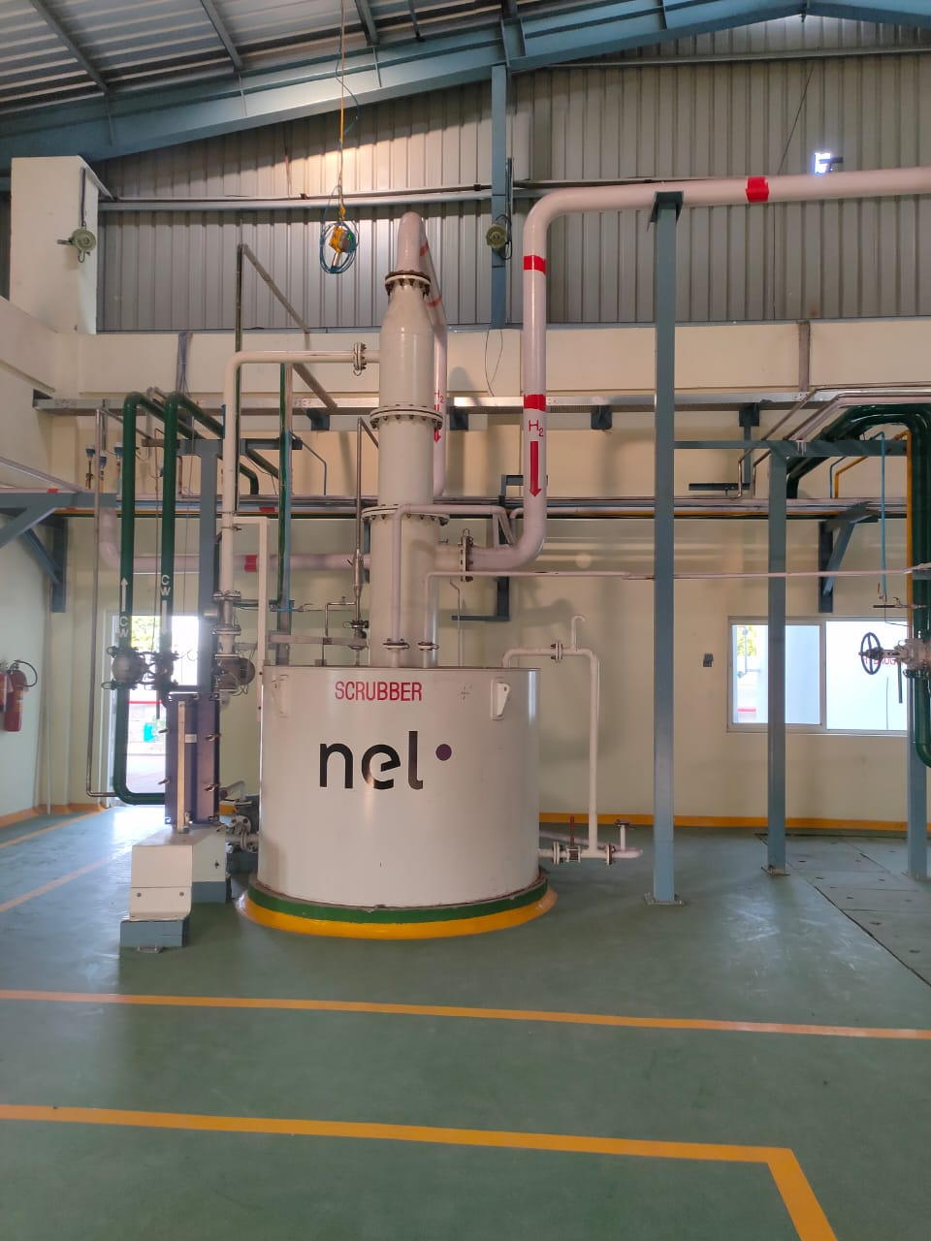

Slide 25
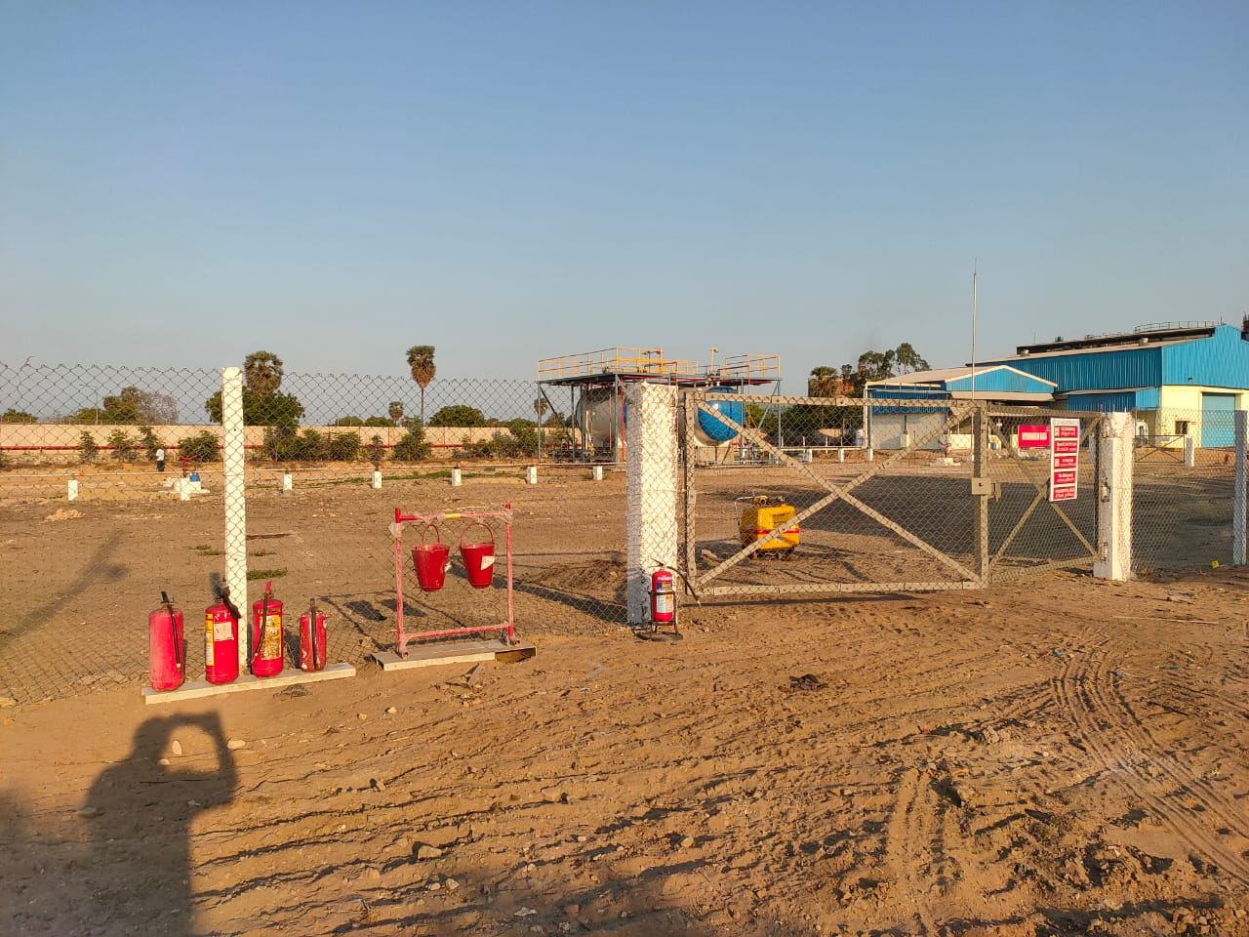

Slide 26
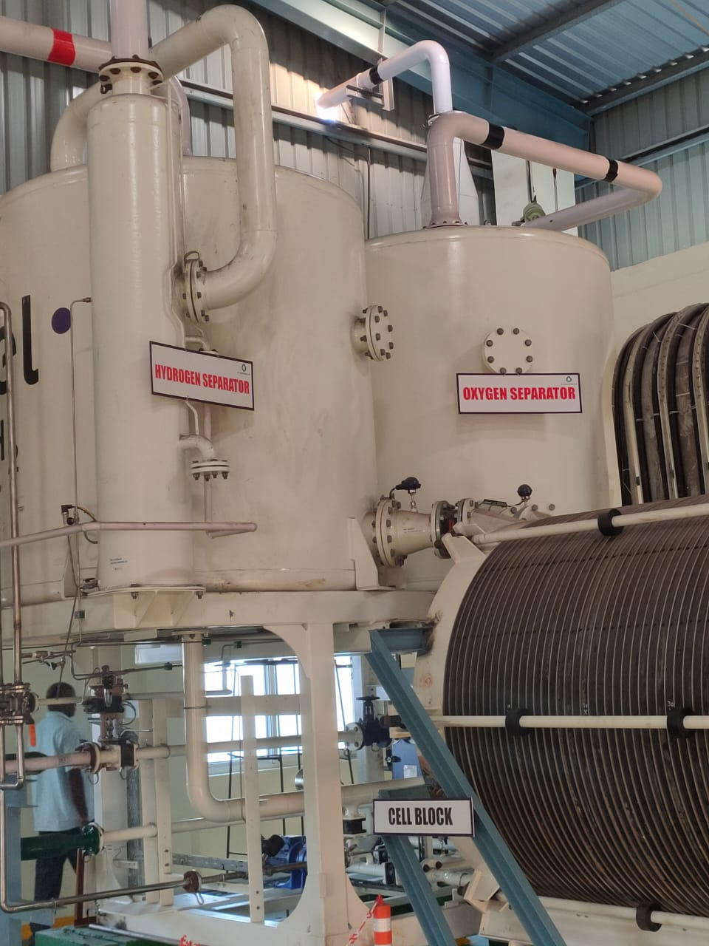

Slide 27
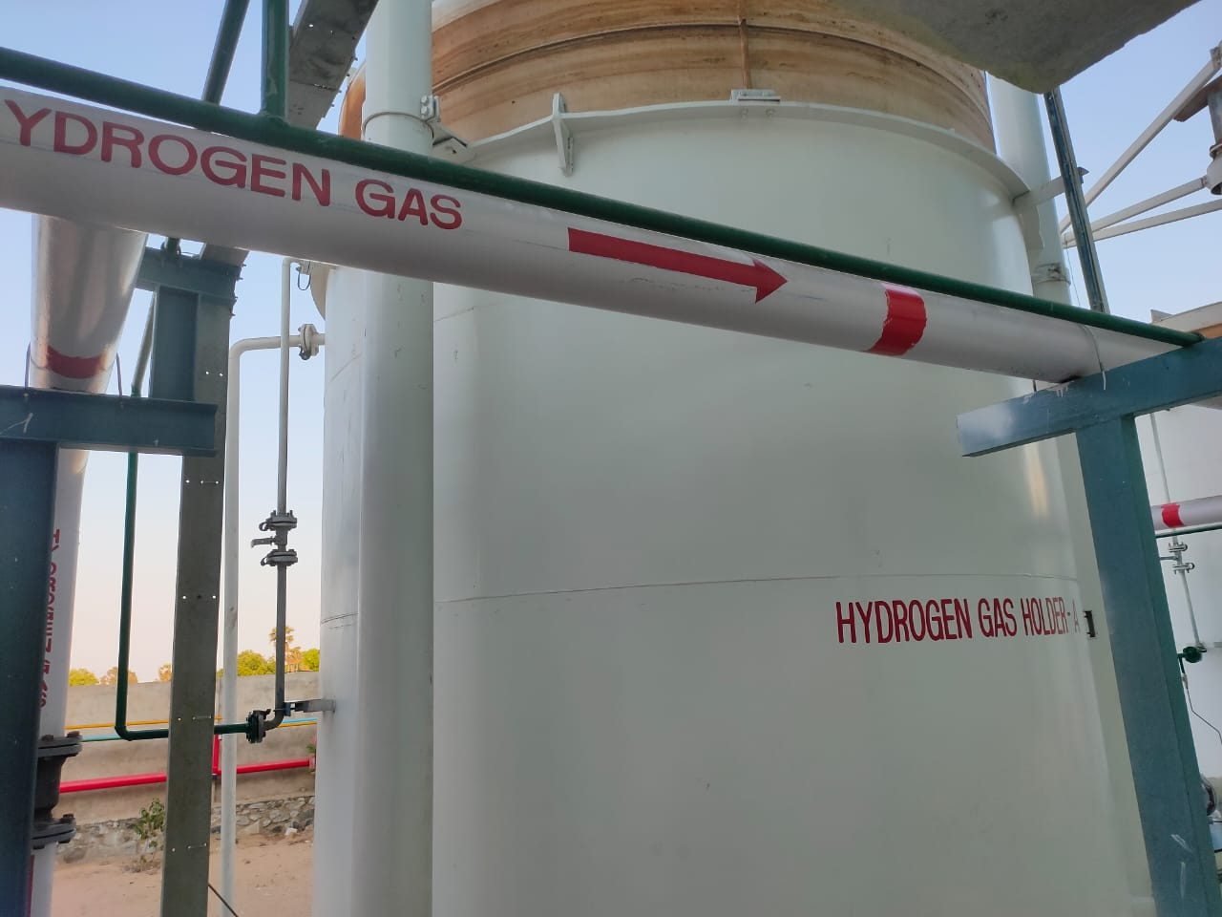

Slide 28
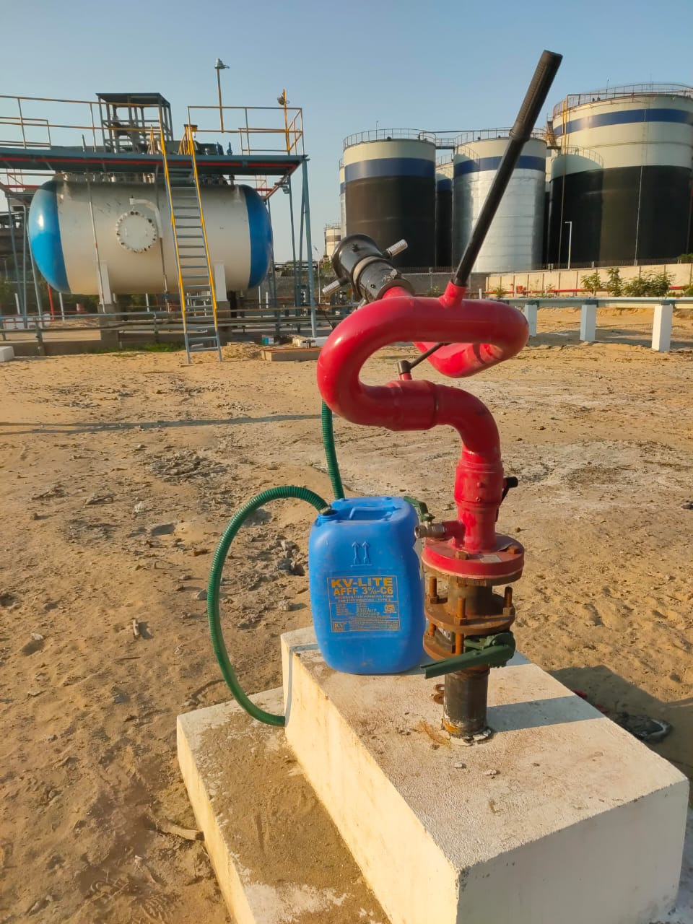

Slide 29
Ca & Zn Stearate
Pictures

Slide 30
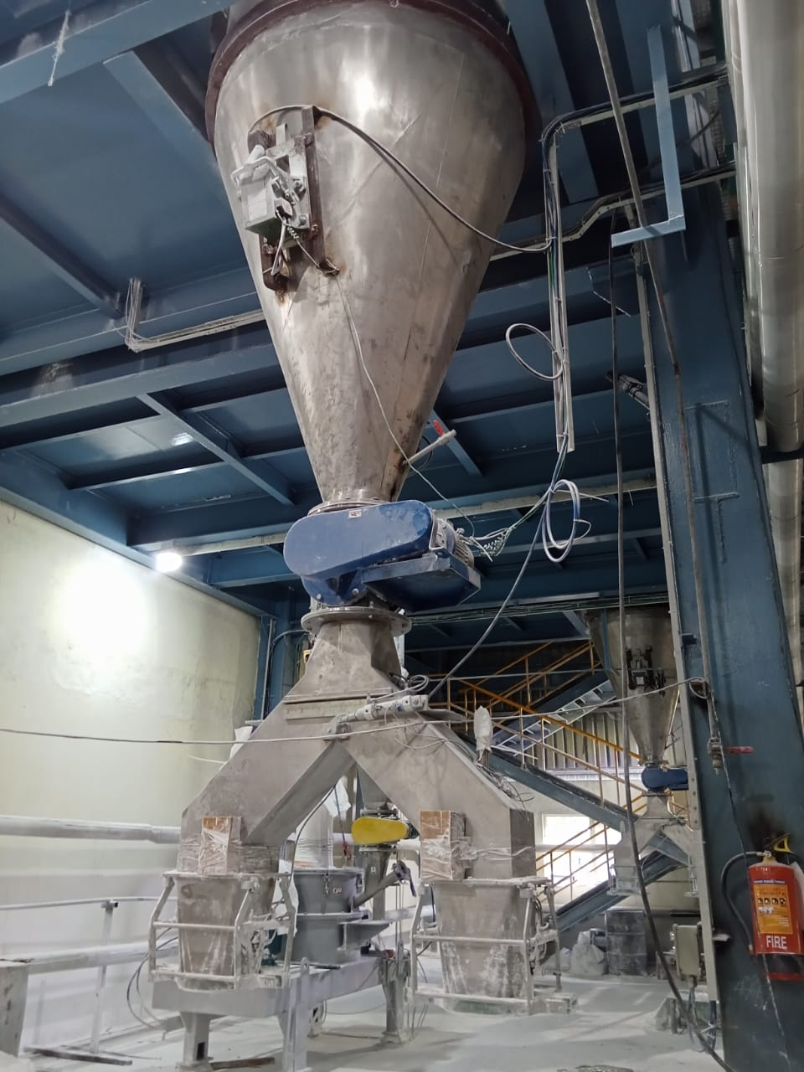

Slide 31
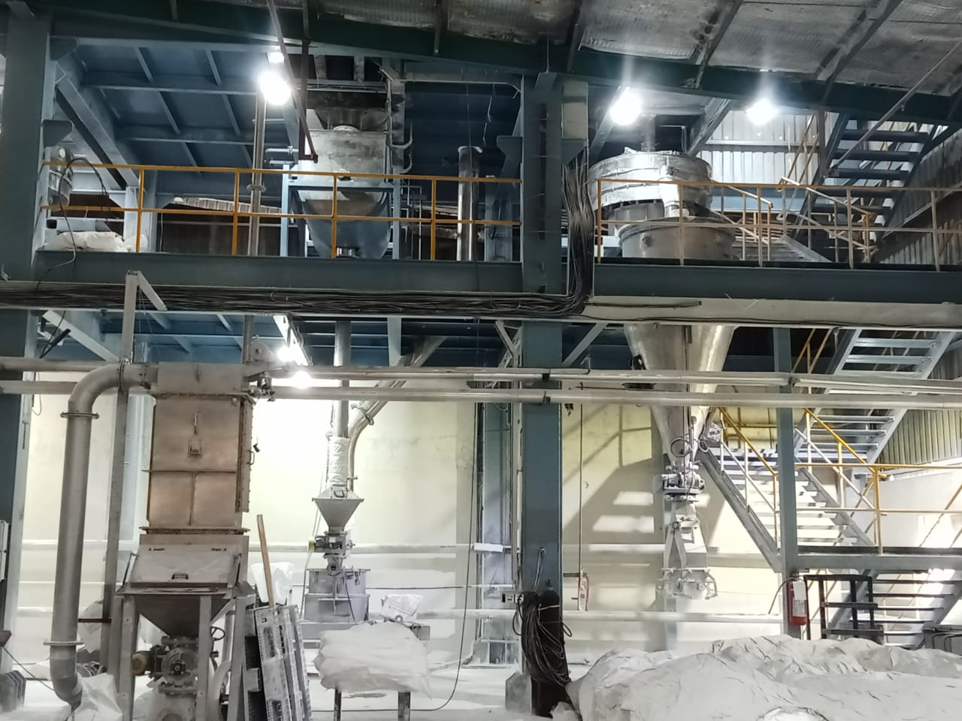

Slide 32
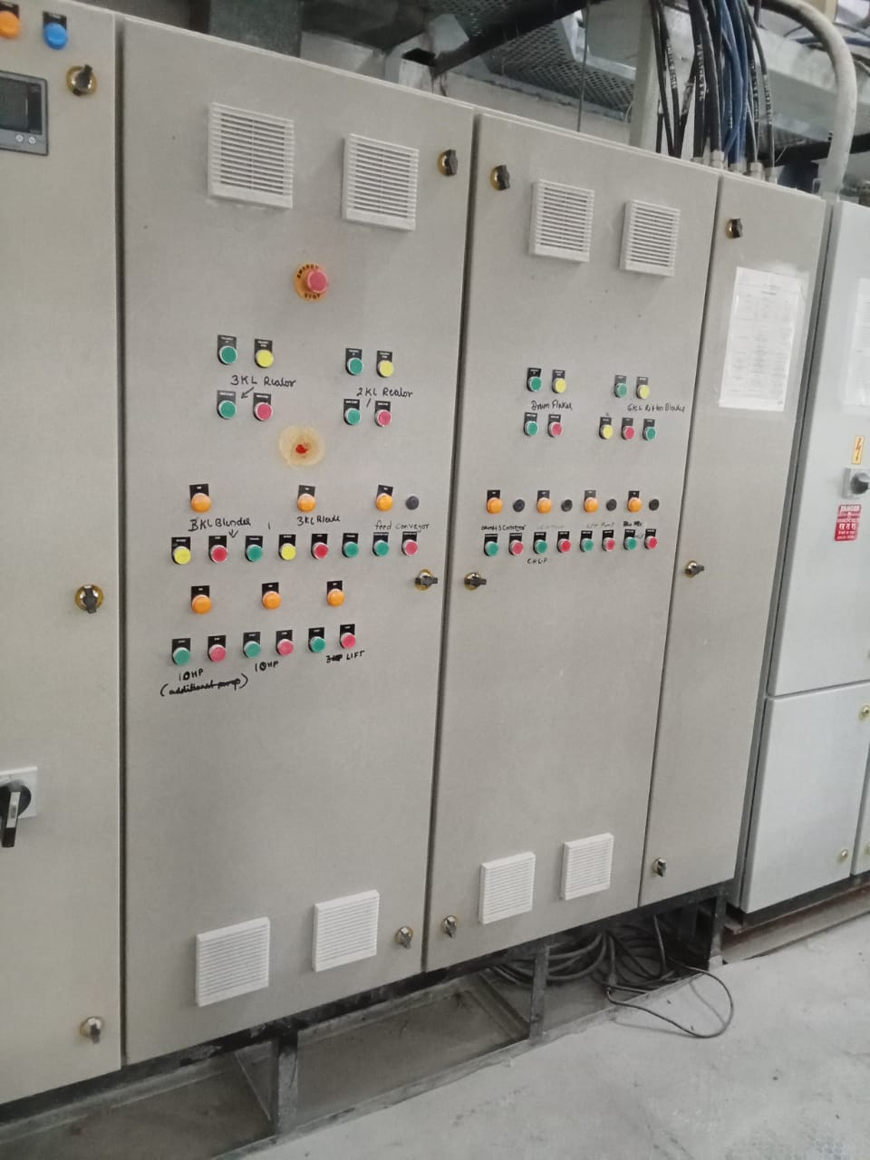

Slide 33
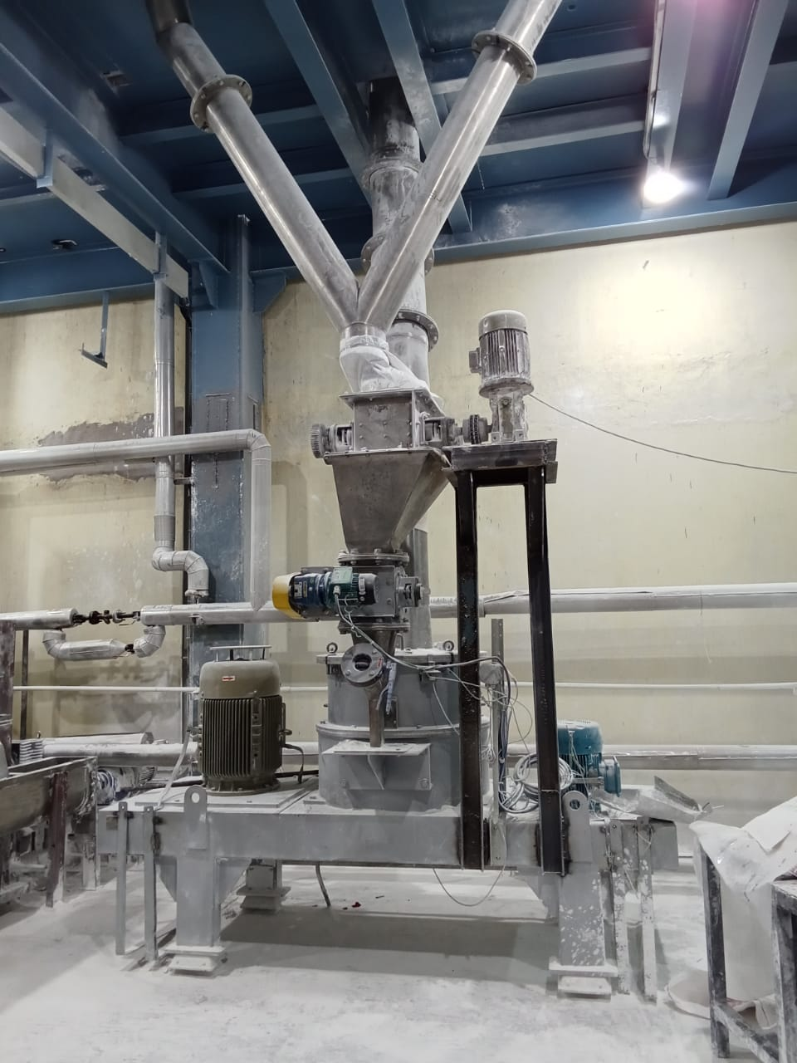

Slide 34
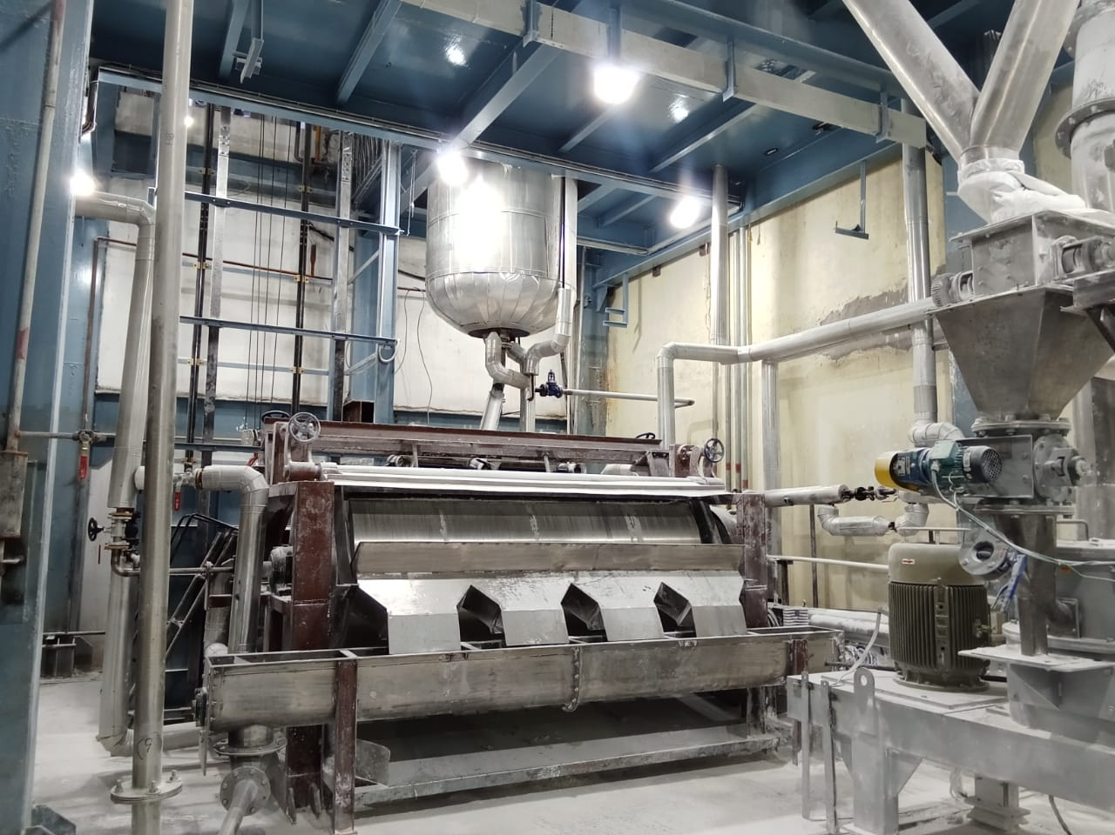

Slide 35
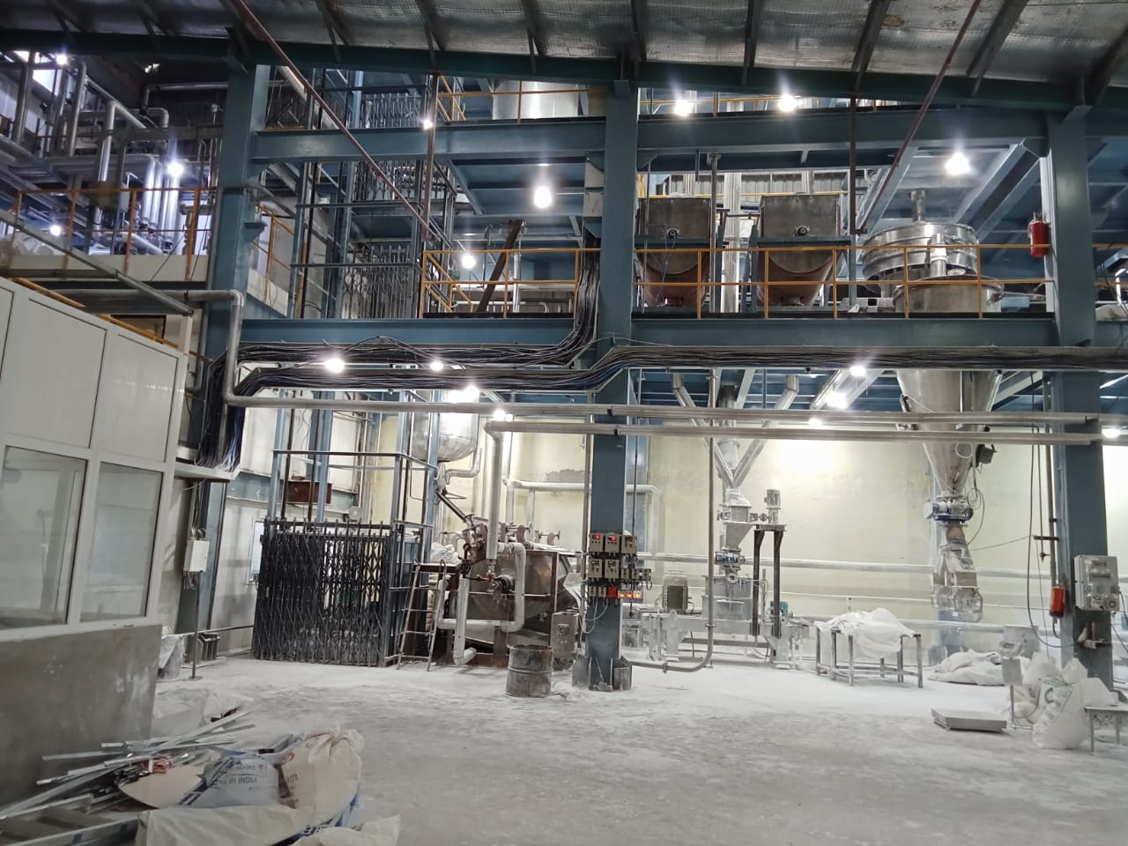

Slide 36
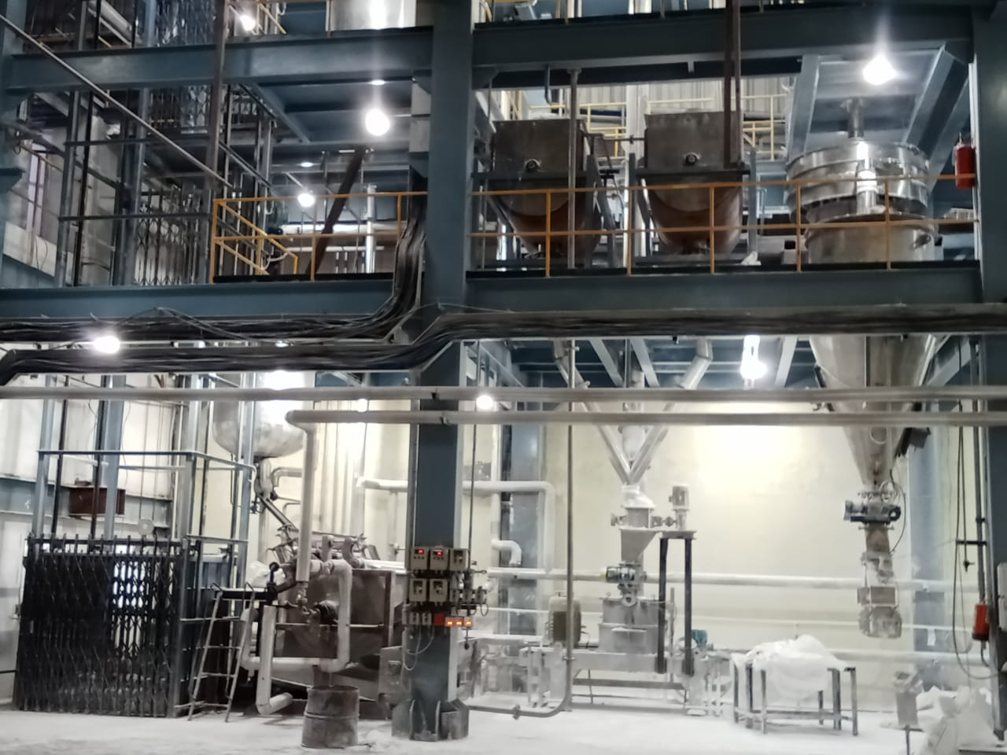

Slide 37
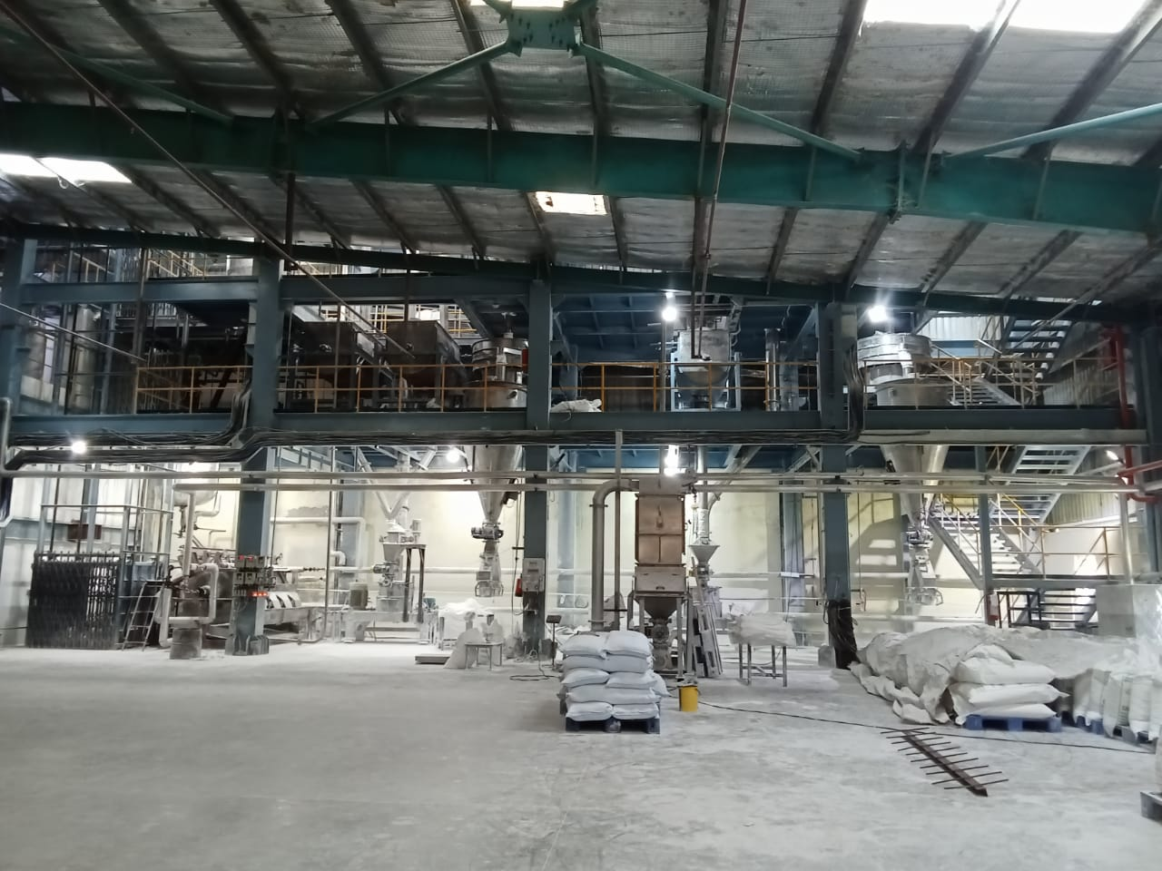

Slide 38
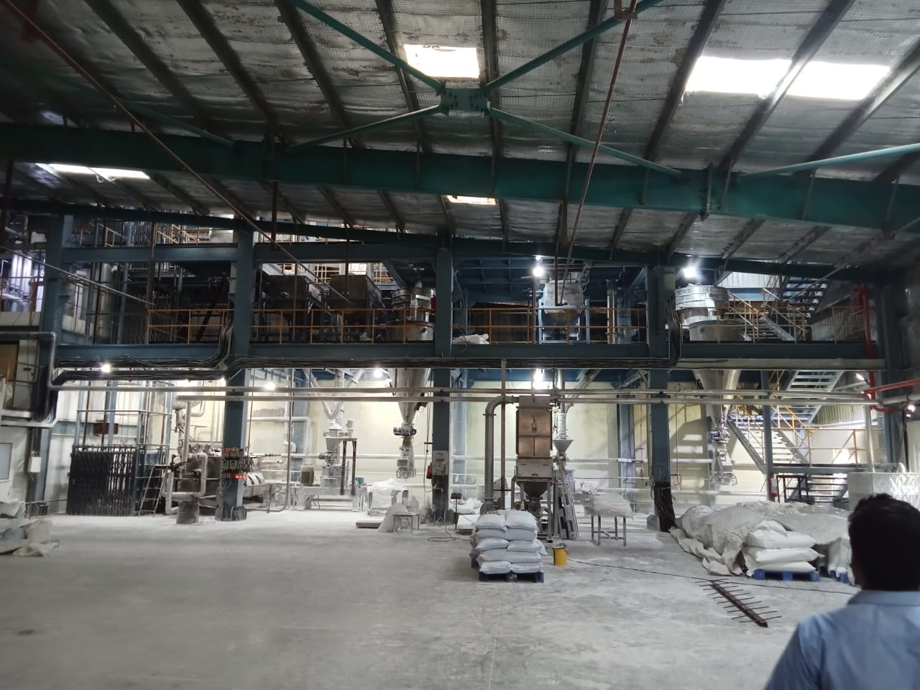

Slide 39
To take steps for completing the projects as per committed schedule and ensure that there is no delay, which will add up additional costs

Slide 40
IDENTIFIED VARIOUS REASONS FOR PROJECT DELAYS AND NEED TO TAKE PRECAUTIONS

Slide 41
NEED TO USE WATERFALL METHODOLOGY WHEREIN THE PLAN, BUDGET, TIME FRAME IS FINALISED AND NO CHANGES DURING THE PROJECT

Slide 42

THANK YOU

